Slide 1
SMART HEALTH MONITORING SYSTEM
VINIT K
ANNAPOORNA G
K PRASAD
GUIDE BY:
V SHIVA KUMAR
Assistant Professor

Slide 2
Contents
Introduction
Existing System
Proposed System
Problem Statement
Technology Used
System Architecture
Subsystem Architecture
Results/System Snapshots
Benefits
Conclusion

Slide 3
Introduction
We are developing Smart Health Monitoring System(SHMS), is to solve the health related problem, SHMS is device comprised of different sensors to acquire the information regarding Human body temperature , heart rate , further transmit this information on the IOT sever then Doctor can accessible over the internet
Health is a fundamental element of people need for a better life . The global health problem has created a because of certain factors such as poor health services, the presence of large gaps between rural and urban areas, physicians, and nurses unavailability during the hardest time.
To overcome this, IOT is best platform, because in rapid growth of technologies wireless technology is ruling worldwide.

Slide 4
EXISTING SYSTEM
There is no proper format view the data for the Doctor.
To monitor the conditions of patient using existing wireless technologies were quite convoluted.
There is no continues Health monitor.

Slide 5
Proposed System
Proposed system consists of following sensors and modules
Arduino Uno
GSM Module
Pulse Sensor
Temperature Sensor
Humidity Sensor
Solar power
We proposed a nonstop health tracking.
The patient Health condition data store the patient information’s in server.
Solar Power Used to SHMS.

Slide 6
PROBLEM STATEMENT
The global health problem has been increasing day by day due of poor health services and lack of medical experts.
Lack of hospital in ruler area due to high quality hospitals poor people not get the proper health care from financial problems.
many patients are not getting proper help during this pandemic situation and it is difficult for the doctors in pandemic situation.

Slide 7
Technology Used
Arduino Uno
Thing speak website

Slide 8
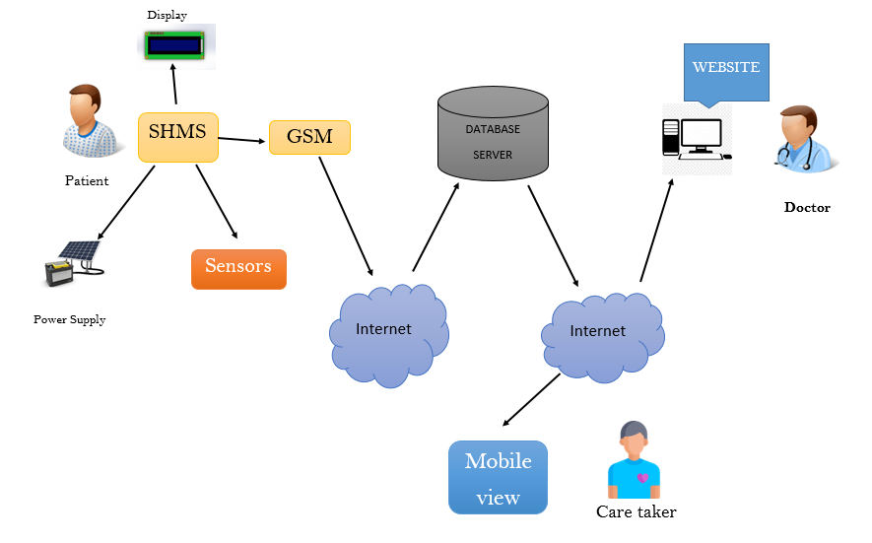
SYSTEM ARCHITECTURE

Slide 9
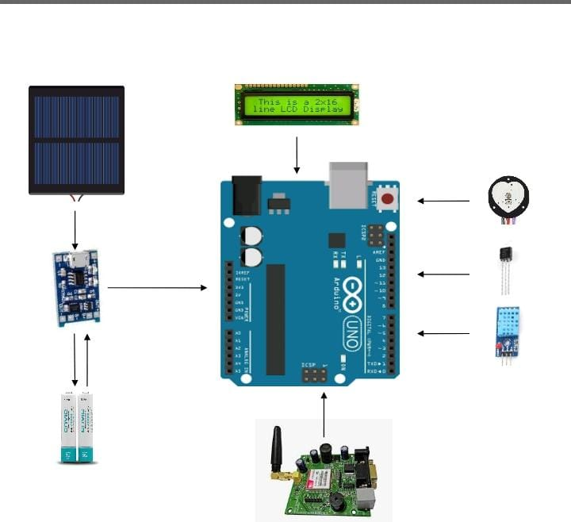
Subsystem Architecture

Slide 10
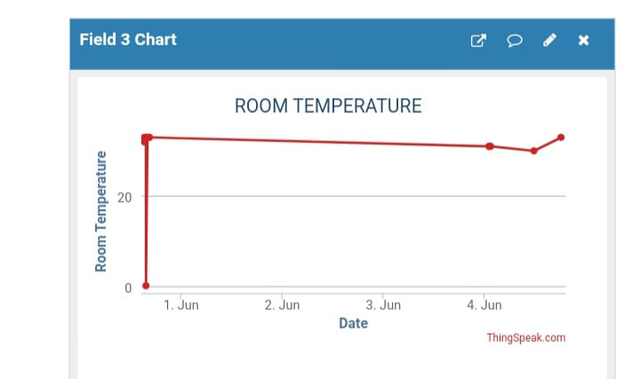
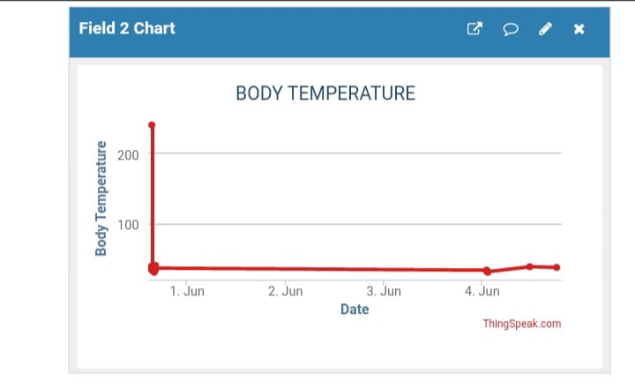
Results/System Snapshots

Slide 11
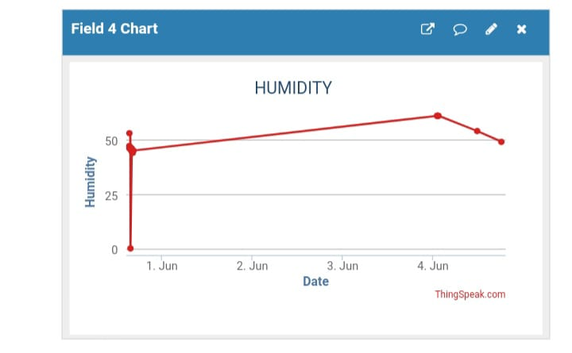
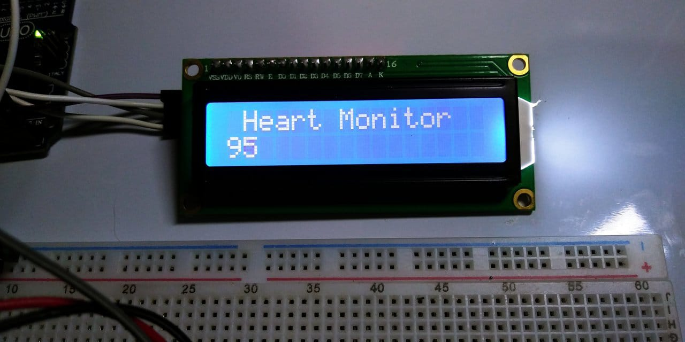

Slide 12
Benefits
Accuracy
Economy
Better patient experience
Improved disease management

Slide 13
Conclusion
An efficient SHMS is developed to monitor the up to date status of the patient irrespective of the presence of the doctor.
The system collects information like temperature, blood pressure and pulse rate of the patient and updates the same to the doctor.
The system is evaluated experimentally and collected the sample data of ten patients to verify the status of patients

Slide 14
Future Work
We will add on the more parameter like ECG and Air quality sensor (C02), can be included as controlling parameters in the future.
This system also developed by using advanced GSM and GPRS technology in future.

Slide 15
References
Rahaman A, Islam M, Islam M, Sadi M, Nooruddin S. Developing IoT based smart health monitoring systems: a review. Rev Intell Arrive. 2019;33:435–40. https://doi.org/10.18280/ria.330605.
Lin T, Rivano H, Le Mouel F. A survey of smart parking solutions. IEEE Trans Intell Transp Syst. 2017;18:3229–53. https://doi.org/10.1109/TITS.2017.2685143

